Slide 1
Creativity and Innovation
What are they and what role do they play in our lives?
Notes:
Examiners is the most enjoyable and thought-provoking group to be with in my life. May I repeat what I said some years ago? When I listen to your talks, “then feel I like some watcher of the skies when a new star swims into his ken.”
Thank you for being here.
My talk is on creativity and innovation, which I think of as the flower and the fruit of the human mind. Creativity brings joy to the heart, while innovation brings food to the body.
My talk is divided into three parts.
To start, we will define the terms creativity and innovation. Then, we will move on to the role these traits have played in the history of homo sapiens and continue to play in the present.
We will also delve into the mechanisms of creativity and innovation, and what blocks and spurs them.
We will end with a consideration of the role they could play in our future.

Slide 2
Definitions
Creativity is doing or thinking something new and interesting to you, but not through mimicry.
Innovation is making progress in some domain of human activity on some problem.
Creativity plays a crucial role in innovation.
Notes:
A simple definition of creativity, and for most purposes an adequate one, is you doing, saying or thinking something new to you, but not through mimicry.
If you repeat what you did before, that is not creativity.
Innovation is solving problems for the first time or in a better way than before, and in such a way that your methods can be adopted easily by others.
And creativity is crucial to innovation.
Children are endlessly creative, doing, saying, and thinking things that are new to them. Waving their arms and legs, rolling over, crawling, sitting up, walking, saying words, speaking a language.
Two examples from my life: my daughter, when she was two, sitting in the bathtub, holding the shower head to her ear and saying, “Hello?”.
And my five-year-old son, when we could not locate a book in the bookcase, saying it had “camel fudge”, by which he meant camouflage.
Why are children born creative? Because of their big heads. They have to be born earlier in their development and much less well developed than other mammals, or their mothers would die. So they are born helpless and have to learn everything by experimenting. And why do we have big heads? Because that was the last great step in the evolution of homo sapiens into the dominant species on planet Earth.
One can say that the evolutionary process has made us creative. I believe that when you do something creative, the brain sends you a dose of the feel-good chemical dopamine. So one could say that if testosterone is the most dangerous chemical in the world, dopamine may be one of the most benign.

Slide 3
Some of mankind’s early creations and innovations
Bipedality
Tool-making
Mastering fire
Hunting
Large brain
Language
……and Migration
Social organization
Art
Music
Exploration
Agriculture
Settlements……
…why?
Notes:
These are some of the innovations of humankind over the last 2 million years or so.
You can see the big brain there, preceded by, among other things, bipedality, tool-making, and hunting.
Of course, you could argue that some of these are just plain Darwinian evolution and have nothing to do with innovation by humans but is, instead, innovation by nature.
I won’t argue the point except to say that the emerging science of epigenetics may have something to say about the mind’s desires being involved in the evolution of species.
The innovations on this list broadly sort themselves into three categories technological, social, and expressive, although if you look. at them more closely, most fall into more than one category.
Another sidebar question is, why did people migrate, and sometimes, as in the Americas, do so with remarkable rapidity? Many scientists think it may been because of climate change.
Some anthropologists argue that it could have been the appearance of more than one individual in a group who wanted to be top dog.
I also wonder whether homo sapiens was created with a wanderlust, like the need for self-expression, and the compulsion to be creative.

Slide 4
Fast forward to the present
Why does creativity die out?
The solution – creativity applied to innovation
Notes:
Creativity is killed by most educational systems. There is wonderful TED talk by Sir Ken Robinson on this topic.
Making a living by being creative is difficult, although the Examiner Club is filled with people who have done it.
We will reserve for the discussion the question of why it is difficult, and for now, simply focus on one of the most-used ways to make a living from creativity: apply it to innovation, and then commercialize the innovation through one of humankind’s greatest innovations: industry.

Slide 5
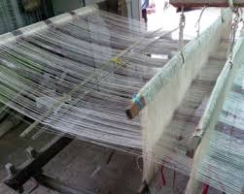
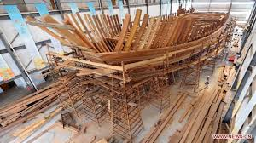
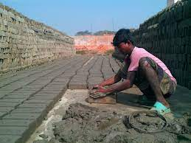
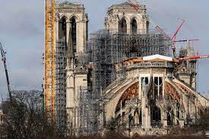
But first– the way to turn creativity into money, which is through the greatest innovation of all…
…. Industry
Notes:
These are ancient industries: agriculture, making cloth, ship-building, brick-making, and construction. These created jobs by the tens of thousands.

Slide 6
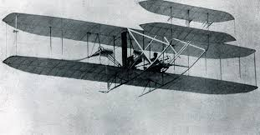
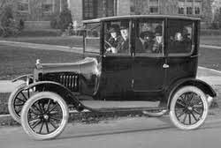
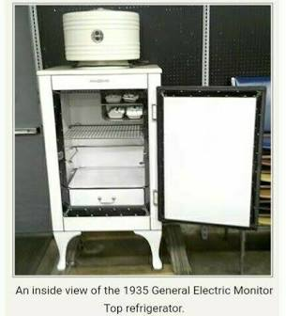
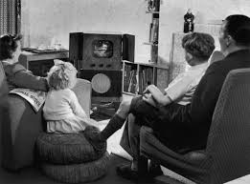
Innovations that launched industries
Notes:
And if you come to modern times, you find the familiar innovations that have transformed our lives and created incredible prosperity - the railroad, airplane, automobile, refrigerator, and television.

Slide 7
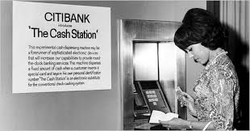
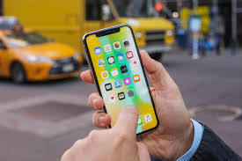
Innovations that launched industries
Notes:
And, more recently, the ATM (get cash almost anywhere!), telecommunications and computers and the smart phone. I will reserve the question of prosperity for whom and what is the cost for the end portion of my talk.

Slide 8
Great Innovations of the last 200 years
Cotton gin, spinning mule
Electric generator and motor
Steam engine
Railroad
Light bulb
Motor car
Aeroplane
Telephone
Television
Traveler’s check
Pocket radio
Nuclear power
ATM
Portable phone
Personal computer
Smart phone
Internet
Search
Social Media?
Notes:
And of course, if you look at the last 200 years, the Industrial Revolution happened. A wry onlooker might exclaim, “It started with bang, the cotton gin, and is ending with a whimper, social media and Facebook.”

Slide 9
Stories from Arthur D. Little – the STAR diagram
Cell phone Smart phone
Compact
?
Easy to use
Compact
Easy to use
?
Affordable
Affordable
?
Light
?
Mobile computing
Light
Large network
Large network
Mobile Internet
Notes:
What makes something a big deal innovation? Consider the dimensions of benefit that a product offers. In this case, the cell phone. The ways in which the smart phone improves on the older cell phone is to create two new dimensions of benefit, mobile computing, and mobile access to the internet. It is worse on almost all the other dimensions. But the advantages are big enough to make consumers pay a thousand dollars more and flock to them in record numbers.

Slide 10
Where do innovations come from?
Problems in search of a solution
Ideas and inventions in search of an application
Just plain problems
Just plain desire or ambition
Notes:
Let’s examine life story of innovations. Where do they start, how are they developed, and what happens after they enter the market?
Where do they start? In the mind of an individual.
“Can I go places without having to feed and clean up after my horse?”
“We’ve got this incredible technology (radar) that can kill birds in the sky. Why can’t we cook things with it in the kitchen?
“We have massive computers that fill a room and puny little calculators? Why can’t we have small computers for the home?”
“I’ve got a problem. I am too groggy in the morning to make coffee, and without coffee, I can’t get ungroggy.”
“I want to do something interesting with the Internet. Sell things? Search for something?”

Slide 11
The innovation process
Notes:
And then the innovation process unfolds, as shown in this fanciful diagram that I was very accustomed to seeing during my days at Arthur D. Little. The road is a rocky one, with unbridled optimism followed by the depths of gloom.
And at each bottoming out point, there is another burst of creative insight, or the innovation-to-be dies. And in some small fraction of all the cases, the team experiences success, which is defined as, we have a product that can be made and sold at a price that the market will like.

Slide 12
Where do the creative insights come from?
Prior knowledge
Trial and error
Prior knowledge, including other people
Analogy (insight)
Bisociation (grand insight)
Notes:
At the beginning and at the intermediate bottoming out times, where do the creative insights come from?
Prior knowledge
Trial-and-error
Analogy
Brainstorming/creative thinking
Bisociation, which I will explore in some detail in a few minutes.
By the way, Walt Disney created and used a method called “Creative Thinking”, which was later taught by his assistant Mike Vance, I took Mike Vance’s course.

Slide 13
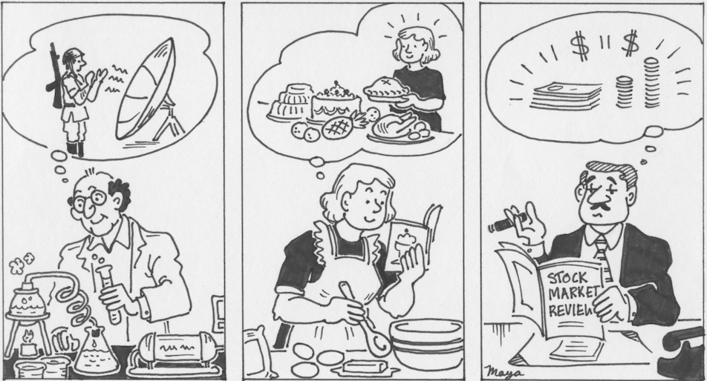
Notes:
Let’s imagine a concrete example, the microwave oven. It combines three hopes. One is cooks hoping for a faster way to cook. The second is Raytheon executives wanting to get into consumer goods, a far reach for a company steeped in defense products. The third is a guy who knows that microwave radar can heat things up.

Slide 14
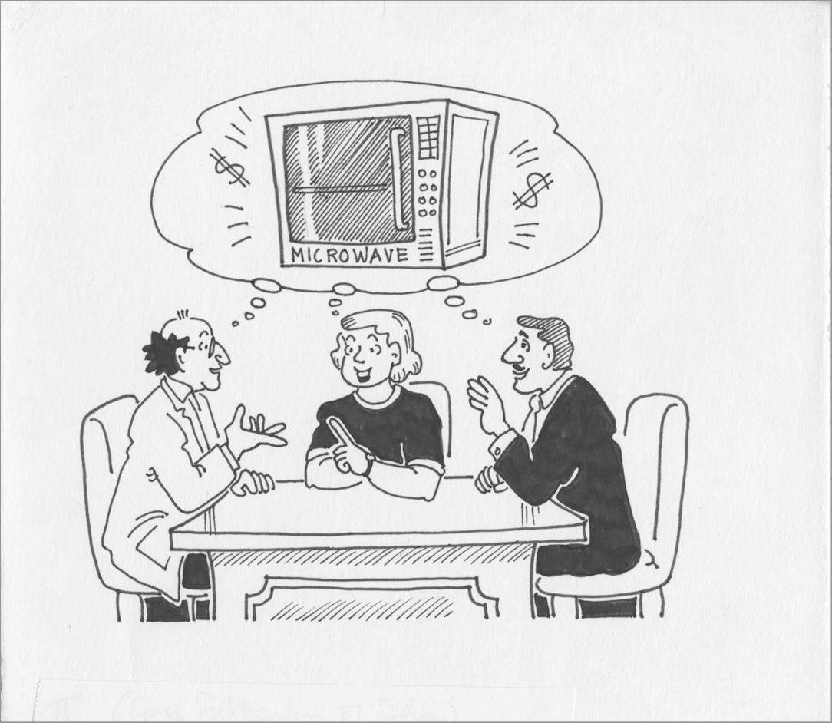
Notes:
The next step is, these three desires combine in an individual’s mind.

Slide 15
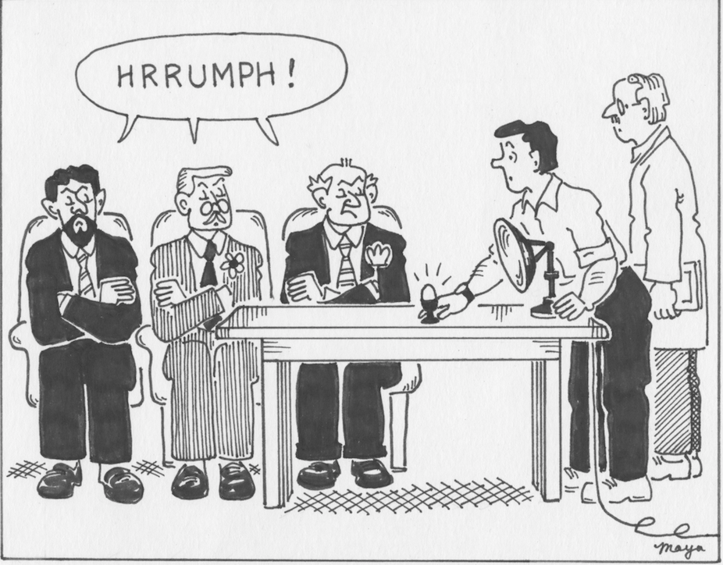
Notes:
The executives of Raytheon are skeptical.

Slide 16
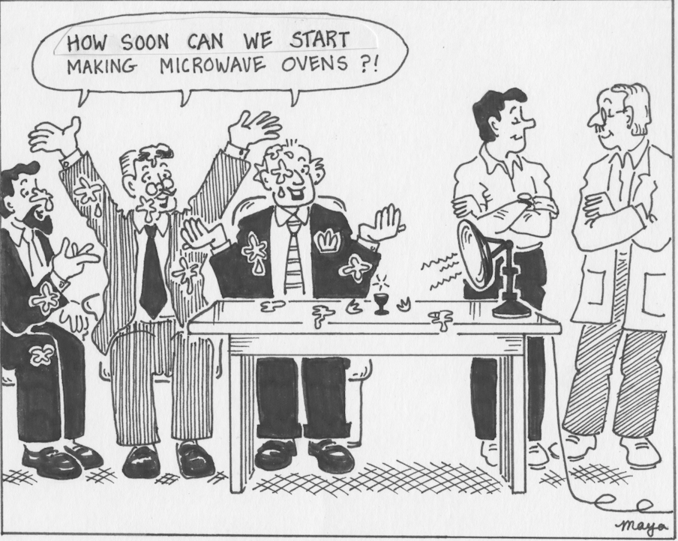
Notes:
Creative insight: use the radar antenna to cook an egg in front of the executives, with the result that the egg explodes in their faces. They are both shocked and delighted.
By the way, these cartoons were drawn for me by my sister Maya, who was one of India’s top cartoonists and one of very few women in that trade.

Slide 17
Creativity at work in the innovation process
Problem: this thing is as big as a refrigerator.
Problem: What should the price be? We have no guidance.
Problem: the cost is too high.
Notes:
Next obstacle: the thing is as big as a refrigerator.
Creative insight: the big item is the microwave generator. There is a company in Japan that knows something about this. Let’s involve them.
Next obstacle: how to price this?
Creative insight: someone says, it’s as big as an air conditioner. It should cost about the same.
Next obstacle: we don’t know how to bring the cost down low enough for that price.
Solution: involve the Japanese. They know how to bring costs down.
I am sure you get my point. Creativity is everywhere for such a process, but you need a team with adequate diversity.

Slide 18
Life after launch
Success or failure
If successful, endless imitations
And then, and endless series of incremental innovations
Until the next big disruptive innovation comes along
Notes:
What happens next, of course, is the familiar pattern: Success or failure
If success, then endless imitations and price reductions
Then, a seemingly endless series of incremental innovations
And then (and not always) the next disruptive innovation.
After Sears, Walmart. After Walmart, Amazon. After Amazon, who?

Slide 19
Bisociation
Bisociation is analogous to a majestic analogy or metaphor.
It is best illustrated by examples
Notes:
The final, and possibly the most important source of insight is a form of analogy which the novelist/philosopher/polemicist Arthur Koestler called “bisociation”. I will give you some examples.

Slide 20
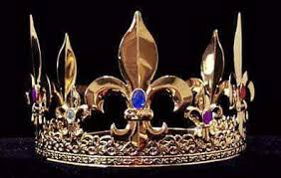
214 BCE
Notes:
The Tyrant of Syracuse, Hieron II, had a crown made from gold, but was then not sure if he had been cheated by the jeweller, with some cheaper metal mixed in with the gold. He asked Archimedes to solve the problem. Archimedes could weigh the crown, but how to figure out if it had the density of gold? For that, he had to measure the volume, which is difficult to do for an intricate shape like a crown. Archimedes got into his bath one day, put 2 and 2 together and came out with five, and the rest is history.
A regal problem and a bath bisociate.

Slide 21
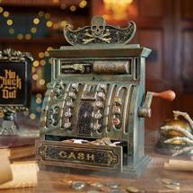
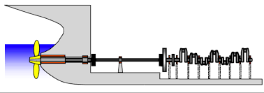
1883
Notes:
In 1871, James Ritty became a saloon owner in Dayton, Ohio. Unfortunately for Ritty, some of his employees stole money from the business. In 1878, while on a ship bound for Europe, Ritty saw a machine that counted the number of times that the ship's propeller completed a revolution. Using the same sort of technology, Ritty became convinced that he could invent a machine that could keep track of his sales. Ritty returned to the United States, and with the assistance of his brother, a mechanic, he invented the first cash register in history.
This invention was the foundation for the National Cash Register, at one time one of America’s most prominent companies.
A business with thieving employees and a device on a ship’s propeller shaft bisociate.
.

Slide 22
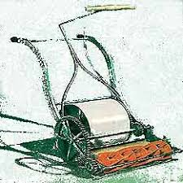
1830
Notes:
Formal lawns with neatly manicured grass began appearing in France in the 1700s, tended to by grazing animals or hand-cut with shears and scythes. In 1830, Englishman Edwin Bear Budding was granted the patent for the first mechanical lawn mower, based on a tool used to uniformly cut carpet and comprised of a series of blades around a cylinder.
Lawn maintenance and carpet-making bisociate.

Slide 23
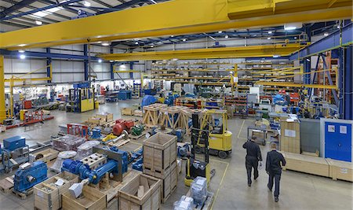
1935
Notes:
Toyota’s factories in post-war Japan were cramped for space and could not afford the space occupied by inventory on the factory floor. The President, Kiichiro Toyoda, on a visit to the USA, saw how grocery stores kept inventory in an attached warehouse and re-stocked the shelves every so often. From this was born Just-in-time.
Over-crowded factories and grocery stores bisociate.
Of course, the Toyota story is much larger than that. They asked, why do we need material between the machines? Ah! It’s because machines break down, and we can’t have the whole line stop because of one machine. So, they worked on why machines break down, and dramatically improved the reliability of their machines. This brought down cost and improved quality. They then worked on improving the reliability of everything in the manufacturing system. That is the essence of the Japanese manufacturing revolution.

Slide 24
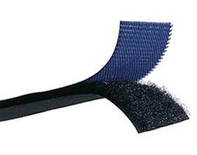
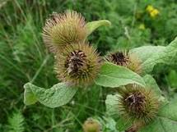
1941
Notes:
A man named George de Mestral, a Swiss engineer, while hunting in the Jura mountains in Switzerland in the 1940s, saw that cockle-burrs were stuck on his pants and in his dog's fur and wondered how they attached themselves. Under the scrutiny of the microscope, he observed the hooks engaging the loops in the fabric of his pants. He figured out how to manufacture hook-and-loop fasteners, and Velcro was born.
Burrs bisociated with clothing fasteners.

Slide 25
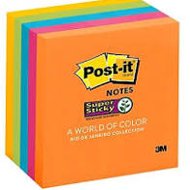
1977
Notes:
Spence Silver, a scientist at the 3M Company, could not think of a use for the new type of adhesive he had created, but he could not let it just go. He approached Art Fry, a senior manager at 3M, who saw the glue as a solution to an unexpected problem. A weekly churchgoer, Fry's paper bookmarks that he used to find hymns were always falling out of hymnals between practice on Wednesday and church service on Sunday. Post-it Notes solved this by sticking where they were placed but importantly not damaging the pages.
A failed glue bisociated with a chorister’s problem.

Slide 26
Stories from Arthur D. Little – the STAR diagram - 3
Household glue 3M’s glue
Ease of use
?
Ease of use
Breadth of use
?
Breadth of use
Safety (non-toxicity)
Safety (non-toxicity)
?
Bond strength
Bond strength
?
Shelf life
Shelf life
Worse on key dimensions
Notes:
Let’s briefly consider why the Post It was such a hit. The glue it used was worse than traditional glue on two key dimensions – breadth of use and bond strength. The Post It focused on a single use and converted the lack of bond strength into an advantage.
Replace the question mark with a dimension called “peelability”.

Slide 27
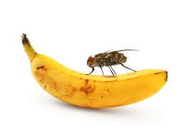
Notes:
And perhaps the ultimate form of bisociation is the pun. Do you get the pun in this picture?
Time flies LIKE an arrow. Fruit flies LIKE a …..?
Bisociating one use of the word “like” with another.

Slide 28
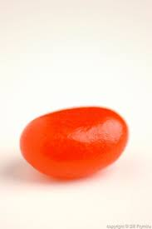
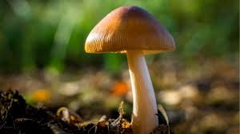
happen?
When does bisociation happen?
Person is “at the frontier” – the cutting edge
Deep attachment to the problem
Breadth of interests but also with depth
Notes:
Bisociation happens when there is a combination of factors:
The person is at “the frontiers”, navigating unfamiliar territory.
At random moments, but only if the person is attached to the problem and carries it around 24 hours a day. 9-to-5 workers do not bisociate.
The person has a profile of interests that is both broad and deep. In my fanciful terminology, neither a carrot nor a jellybean, but a mushroom. To which someone once responded, “You know, of course, that mushrooms are what you keep in the dark and feed horseshit.”

Slide 29
What blocks and what spurs creativity?
Blocks
Old-fashioned education (meant to create workers for factories)
Dogma (including religious)
Criticism
Spurs
The challenge – difficult but not too difficult
Devotion to the need/problem
Lightness of mood -- letting the lightning strike, roaming the universe
Humor
The joy of the new
Notes:
What blocks or spurs our creativity?
The biggest blocker is criticism of creative thinking. Hence Walt Disney’s division of problem-solving sessions into a creative thinking piece followed by a critical thinking piece. If you wish, I can send you a summary of Walt Disney’s method.
As to the spurs, I will highlight the three that motivate me the most:
Nature of the difficulty – challenging, but not impossible. A highly creative friend who is an architect told me his best work was in situations such as designing a house for a plot with a tree in the middle of the plot that the owner wanted to preserve.
Devotion to the problem
Lightness of mood -- letting the lightning strike, roaming the universe,
Humor
I am sure you can add a lot to this list from personal experience.

Slide 30
We have these incredible talents of creativity and innovation
How are we going to put them to use to solve our problems of pandemics, ocean level rise, and climate change?
Notes:
And, so, my question to you, on what feels to me like the final frontier for creativity and innovation…
We are confronted by a dismal future, with pandemics, ocean level rise, and climate change. These are the results of the industrial revolution and the consumption-focused societies we have built.
What will our creative response be? It has to be creative, because I cannot see anything off-the-shelf that would work.
Do we need technological innovations such as solar, wind, batteries, carbon capture, and fusion?
Or social ones involving massive changes in behavior and consumption?

